Slide 1

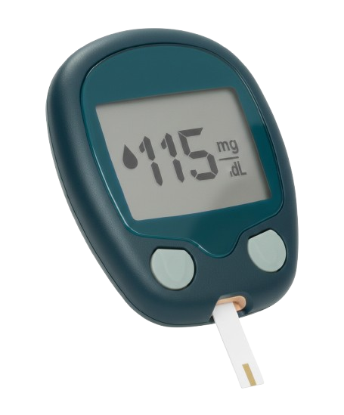

DiaMate
Because Every Reading Matters

Slide 2
Project Insights
Requirement Analysis
AI
Models
System
Design
Project Planning
Agenda

Slide 3
Project Insights
Requirement Analysis
AI
Models
System
Design
Project Planning
Agenda

Slide 4
Project Insights
AI Models
System Development
Cost & Sales
Future Work
Agenda

Slide 5


Slide 6
Direct Complications of Diabetes
Retinal Damage
Vision impairment
or blindness
Stroke
3
Amputation
Heart and vascular
diseases
Diabetic foot ulcers
2
4
Nerve Damage
Kidney failure&
Coma
tingling, loss of
sensation, limb pain
1
5
Dialysis & hypoglycemia
or hyperglycemia
Diabetes affects over 537 million people worldwide, and in Egypt alone, nearly 20% of adults are living with the disease,
1 out of each 5 Egyptian.
with millions still undiagnosed.
Notes:
⚠️ الأضرار المباشرة لمرض السكري
تلف الأعصاب (تنميل، فقدان الإحساس، آلام بالأطراف).
أمراض القلب والشرايين وزيادة خطر الجلطات.
ضعف أو فقدان البصر نتيجة تلف شبكية العين.
فشل كلوي قد يتطلب غسيل كلى.
بطء التئام الجروح والالتهابات المتكررة.
قرح القدم السكري التي قد تؤدي إلى البتر.
نوبات هبوط أو ارتفاع حاد في السكر قد تسبب غيبوبة.

Slide 7
Diabetes impairment affects millions of people worldwide.
Risk of diabetes gain
6.5%
Diabetes affects over 537 million people worldwide, and in Egypt alone, nearly 20% of adults are living with the disease,
1 out of each 5 Egyptian.
with millions still undiagnosed.
Population
93.5%
The Problem:
High prevalence
Poor daily monitoring
Limited doctor access
Expensive complications

Slide 8
Diabetes impairment affects millions of people worldwide.
Risk of diabetes gain
6.5%
The Problem:
High prevalence
Poor daily monitoring
Limited doctor access
Expensive complications
Population
93.5%
Diabetes affects over 537 million people worldwide, and in Egypt alone, nearly 20% of adults are living with the disease,
1 out of each 5 Egyptian.
with millions still undiagnosed.

Slide 9
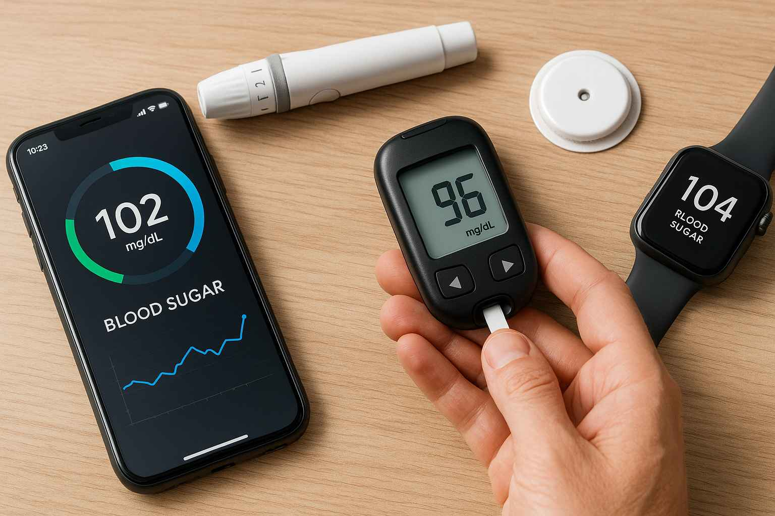

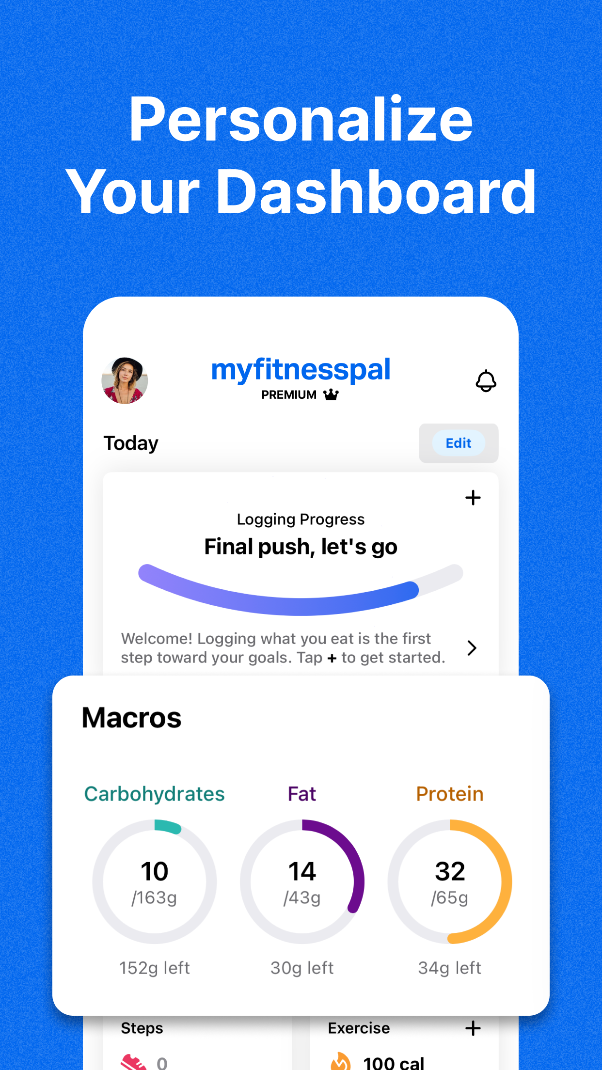
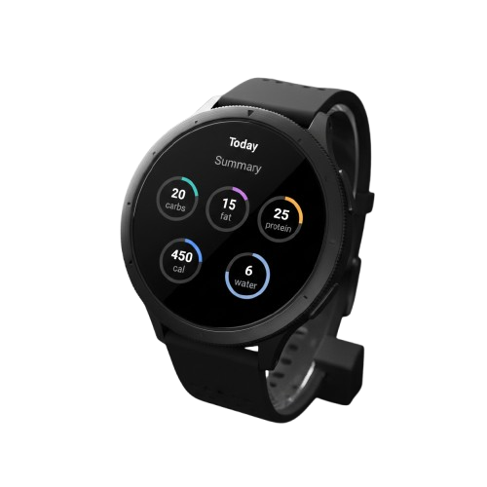
Current Solutions
Solution Type | Main Approach | Limitation / Gap | Solutions
Diabetes Apps | Manual logging | Time-consuming, user fatigue | Smartphone app, logging icon
Hospitals / Clinics | In-person care | Reactive / late detection
Fitness Apps | Activity tracking | Not medically validated | MyFitnessPal
How can we give every patient a 24/7 digital doctor?

Slide 10
Diabetes impairment affects millions of people worldwide.
Risk of diabetes gain
6.5%
The Problem:
High prevalence
Poor daily monitoring
Limited doctor access
Expensive complications
Population
93.5%
How can we give every patient a 24/7 digital doctor?
Notes:
فسألنا نفسنا سؤال بسيط… ليه المريض ميكونش معاه دكتور في جيبه 24 ساعة؟ ومن هنا جات فكرة DiaMate.

Slide 11
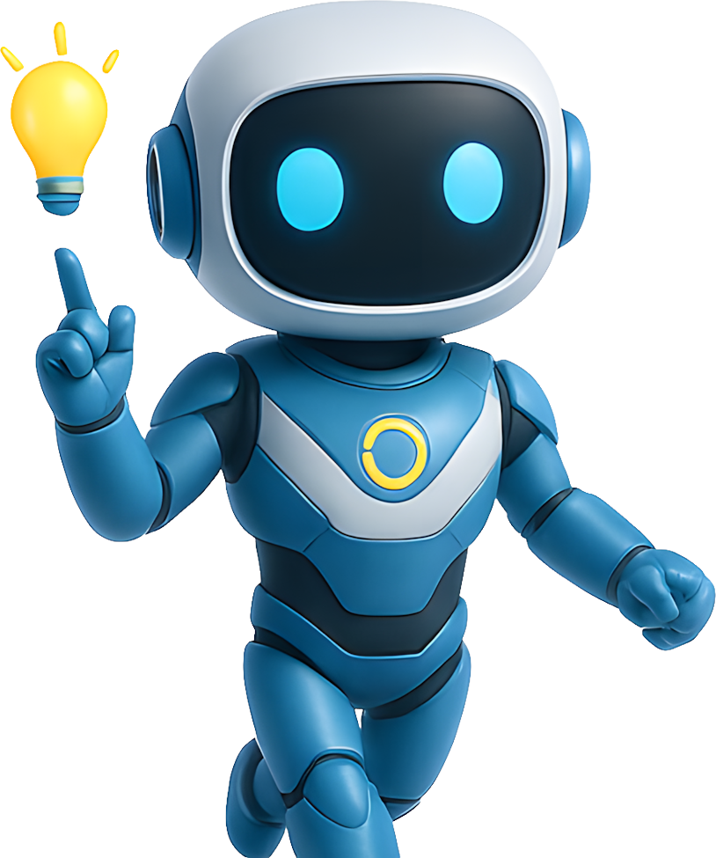
Our Solution
Our project introduces a smart & friendly-chatbot communication system paired with a mobile app, designed to bridge the gap between hearing-impaired and hearing individuals.
It enables real-time, two-way communication without interpreters or pre-recorded tools.

Slide 12
Our Solution
The smart glasses display real-time speech-to-text using an OLED screen and built-in microphone, allowing hearing-impaired users to read spoken language instantly.
The mobile app controls the glasses, activates voice and video capture, and manages data processing for sign language recognition and speech output.

Slide 13
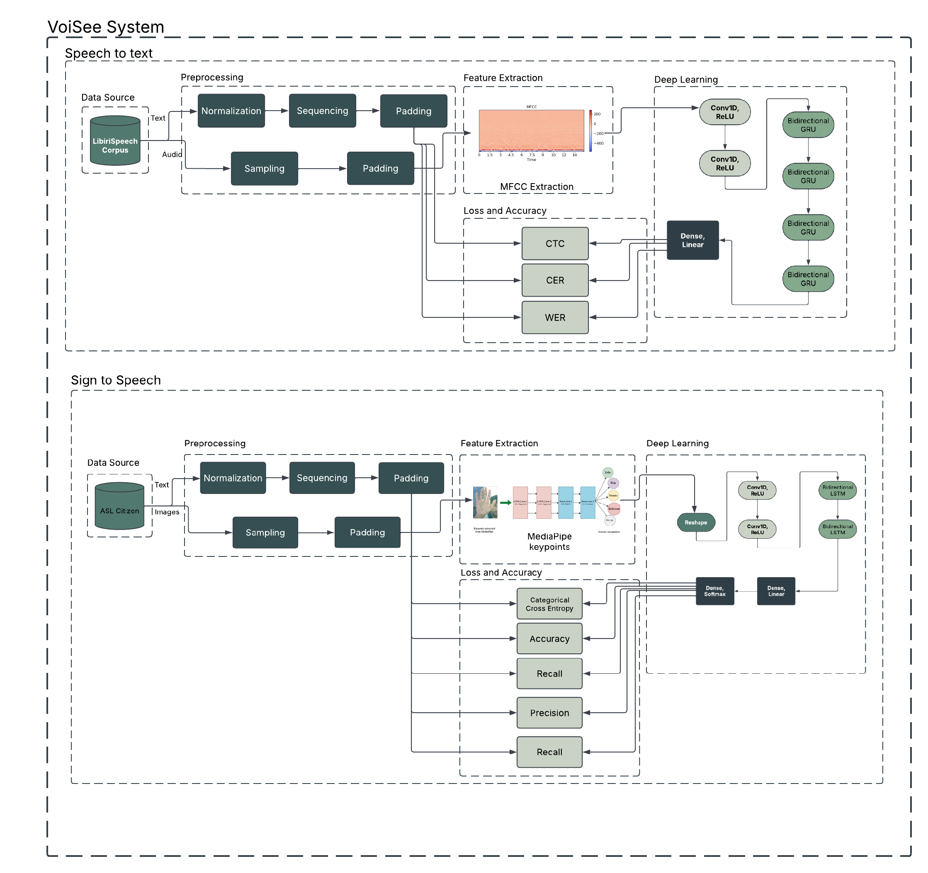
Proposed Framework

Slide 14
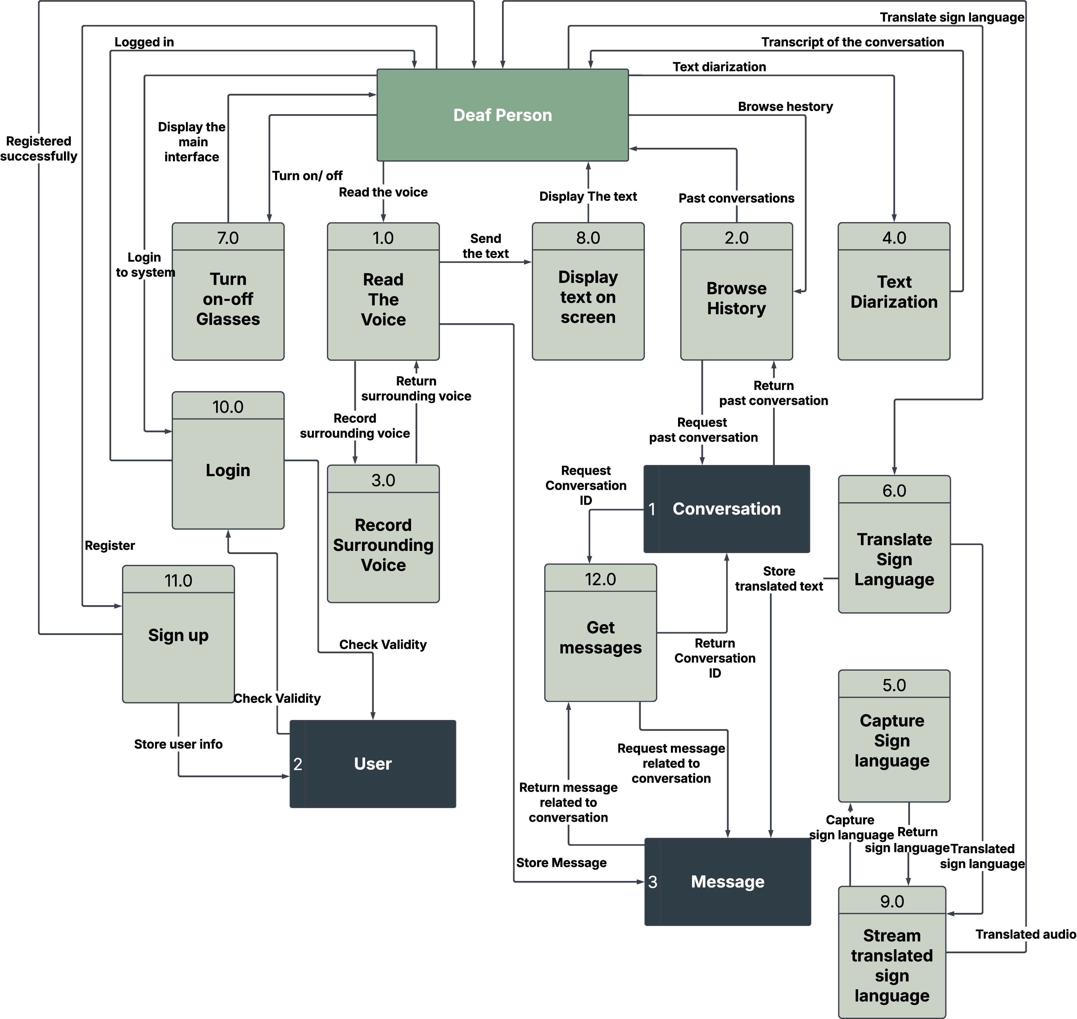
Data Flow Diagram

Slide 15
Project Insights
AI Models
System Development
Cost & Sales
Future Work
Agenda

Slide 16
Project Insights
AI Models
System Development
Cost & Sales
Future Work
Agenda

Slide 17
AI Models
System Development
Cost & Sales
Future Work
Agenda

Slide 18
Speech to Text

Slide 19
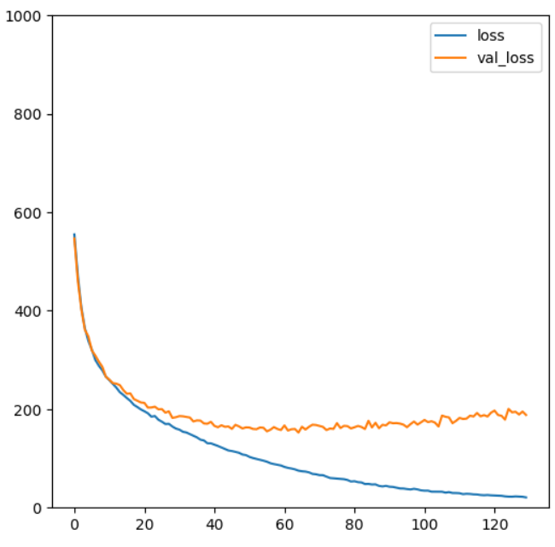
Model 1
Metrics
WER
62%
loss
CER
23%
WA
38%
CA
77%
Error Rates And Accuracies
epochs
Comparison of Speech Recognition Error
Rates and
Accuracies

Slide 20
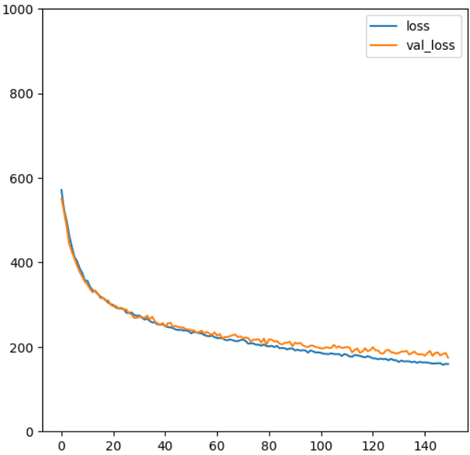
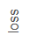
Model 2
Error and Accuracy Rates
WER
51%
CER
18%
WA
49%
CA
82%
epochs
Rate
Model Performance Metrics

Slide 21
Challenges
After numerous attempts to train a speech recognition model from scratch, we encountered several challenges in achieving consistently high accuracy.
Despite experimenting with various architectures and hyperparameter tuning strategies, the results often fell short of expectations, particularly in handling real-world audio variability and maintaining robustness across different speakers and environments.

Slide 22
Transition to ASR Pre-Trained models
To boost accuracy and simplify development, we shifted from training models to using external ASR Pre-Trained models.
This allowed us to benefit from powerful, pre-trained systems with robust performance.
Train Models
Use Pre- Trained Models
Requires extensive data and time
Leverages existing robust systems

Slide 23
Pre-Trained models Comparison
The table presents a comparison of six speech-to-text APIs based on accuracy, speed, language support, cost, key features, and specific usage notes.
Model | Accuracy (WER)* | Supported Languages | Approx. Cost | Key Features
Google Speech-to-Text | 5–12% | 125+ | $0.96/hr | Real-time, custom models
Azure Speech | 6–13% | 100+ | $1 /hr | Dialect support, model customization
AWS Transcribe | 7–14% | 30+ | $1.44/hr | Speaker diarization, translation
AssemblyAI | 6–10% | 35+ | $0.15/hr | Keyword spotting, speaker detection
Rev.ai | 7–12% | 31+ | $0.12/min | Advanced reporting
Speechmatics | 6–10% | 30+ | $0.24/hr | Accent/language support

Slide 24
Why Assembly AI
Key Strengths of Assembly AI
Seamless Integration
Offers scalable cloud API for quick and easy deployment
Advanced Architecture
Utilizes transformer-based design for better context understanding
Real-Time Optimization
Provides low-latency, production-ready transcription
Industry-Leading Accuracy
Achieves high word accuracy with minimal tuning (~6.6% WER )

Slide 25
Comparison
The table compares three speech recognition models in terms of Model Type, Word Error Rate (WER), and Word Accuracy (WA).
The first two were developed from scratch, while the third is based on Assembly AI.
 | WER | WA | Type
First Model | 62% | 38% | Bi-LSTM
Second Model | 51% | 49% | Bi-GRU
Third Model | 6.6% | 93.4% | Transformer

Slide 26
Speech Diarization

Slide 27
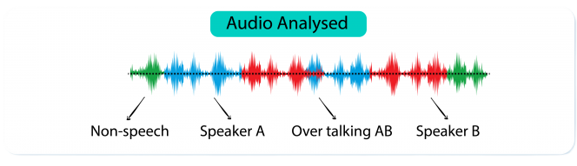
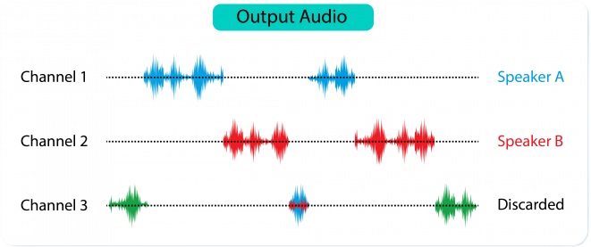
What is Speech Diarization
Speech diarization is the process of identifying who is speaking and when in an audio.
It’s useful in multi-speaker settings like meetings, using voice features to separate and group speakers.

Slide 28
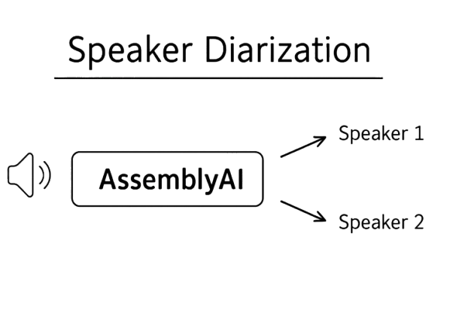
Why AssemblyAI
AssemblyAI provides seamless integration of ASR and speaker diarization, delivering timestamped transcriptions with speaker labels without the need for separate processing pipelines.
It effectively handles unknown speakers and scales reliably across large datasets.

Slide 29
Performance
Performance Metrics of Speech Recognition System
26%
This chart highlights two key performance metrics of the system:
An 18% Diarization Error Rate, reflecting speaker identification accuracy
A 26% Class-Perceived Word Error Rate, indicating transcription accuracy across different speakers.
18%
Class-Perceived Word Error Rate
Diarization Error Rate
Error in speaker identification
Error in word recognition by class

Slide 30
Sign Language About Data

Slide 31
About Data
Video Dataset Breakdown
ASL Citizen dataset:
83,399
Total Videos
Total number of videos
Created by researchers affiliated with Microsoft Research, Boston University, University of Washington, and Rochester Institute of Technology for American Sign Language (ASL).
2,731
Distinct Signs
Number of distinct signs
52
Signers
Total number of signers
Sign Savvy

Slide 32
Data Distribution Across Sets
Dataset Distribution Across Sets
40154
32941
10304
Validation
Medium dataset with 6
Train
users
Test
Largest dataset with 35
Dataset with 11 users
users

Slide 33
Data preprocessing & Feature Extraction

Slide 34
Data preprocessing
Label Distribution Across Video Ranges
Number of Labels
1983
223
1
3
51
3
24
4
1
Video Range
1-10
21-30
31-40
51-60
81-90
101-110
111-120
131-140
141-150
Number of Labels per Video Range
We selected 12,574 videos from the dataset, focusing on the 223-label range due to its balanced distribution and strong model accuracy.

Slide 35
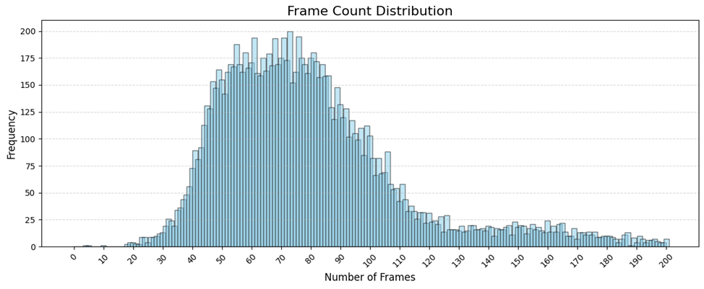
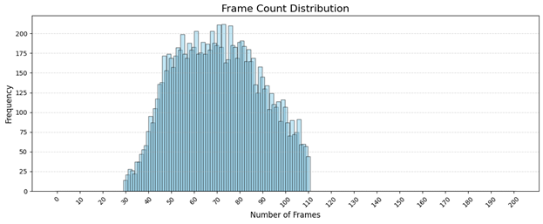
Data preprocessing
We selected videos with frame counts between 30 and 110 to ensure consistency in sequence length and focus on the most frequent range in the dataset.

Slide 36

Data preprocessing
We selected videos with frame counts between 30 and 110 to ensure consistency in sequence length and focus on the most frequent range in the dataset.

Slide 37
Data preprocessing
Decrease in Video Count
12574
10733
Before Frame Cropping
Number of videos before decrease
After Frame Cropping
Number of videos after decrease
After applying frame cropping (selecting videos with 30 - 110 frames), the video count dropped from 12,574 to 10,733 to maintain consistent sequence lengths.

Slide 38
Extract Landmarks
Face Key points
Selecting 132 key points for
detailed facial analysis
How many
key points to
Pose Keypoints
select for each
category?
Selecting 6 key points for
basic pose estimation
Hand Keypoints
Selecting 42 key points for
comprehensive hand
tracking

Slide 39
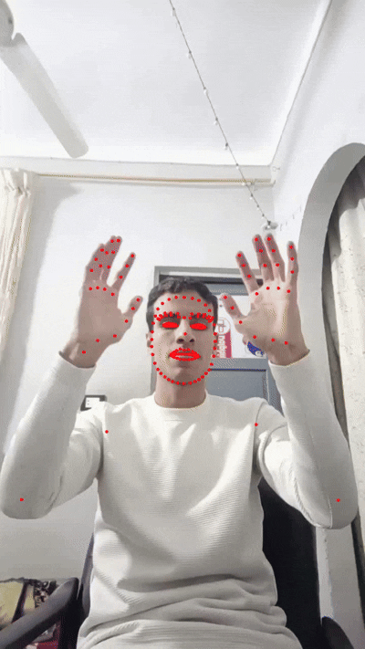
Important landmarks
The most important landmarks for sign language recognition

Slide 40
Data Augmentation

Slide 41
Data Augmentation
Data Augmentation Techniques
Three augmentation methods were applied to enhance model generalization:
Gaussian Noise to introduce slight randomness in landmark positions,
Random Scaling to resize the sequence uniformly, and
Z-Axis Rotation to simulate viewpoint variations in the x-y plane.
Gaussian Noise
Random Scaling
Z-Axis Rotation
Adds slight randomness to landmark positions.
Uniformly resizes the sequence.
Rotates landmarks in the x-y plane slightly.

Slide 42
Data Augmentation
21468
After applying data augmentation techniques, the number of videos increased from 10,734 to 21,468, effectively doubling the dataset size for better model training.
10734
After Augmentation
Initial Count
Significantly increased video count
Starting number of videos

Slide 43
Modeling

Slide 44
Model Data Generator
Data Generator Workflow
Input DataFrame
Shuffle Indices
Get Batch Indices
Get Landmarks
Get Labels
One-hot Encode
Extract class labels for the selected batch
Load the full dataset with landmarks and labels
Shuffle video indices at the end of each epoch
Select indices for the current batch
Extract landmark sequences for the selected batch
Convert labels to one-hot encoded vectors
Using Landmark Data Generator enables efficient batch loading, lowers memory usage, allows real-time preprocessing, and improves model generalization through proper data shuffling

Slide 45
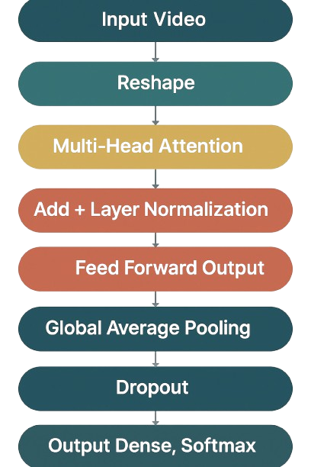
Model Architecture

Slide 46
Model Evaluation
Metrics
Accuracy
95%
Precision
95%
Recall
94%
F1 Score
93%
Performance Score
Model Performance Metrics

Slide 47
Comparison

Slide 48
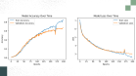
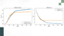
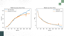
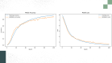
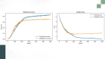
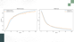
Comparison
The table presents a comparison of three models based on accuracy, precision, recall, F1 score, number of labels, and model type.
 | Accuracy | Precision | Recall | F1 Score | No. labels | Type | Training over time
First Model | 66% | 68% | 66% | 65% | 100 | LSTM
Second Model | 71% | 73% | 71% | 70% | 250 | LSTM
Third Model | 94% | 95% | 94% | 93% | 223 | Transformer

Slide 49
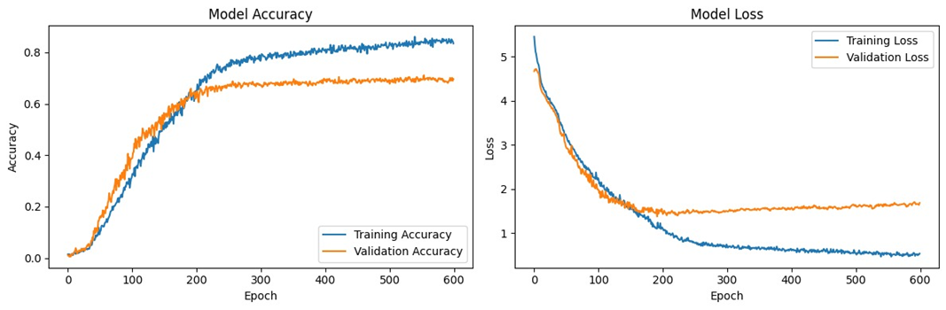
Model 1: Evaluation
Model Training Overtime:

Slide 50
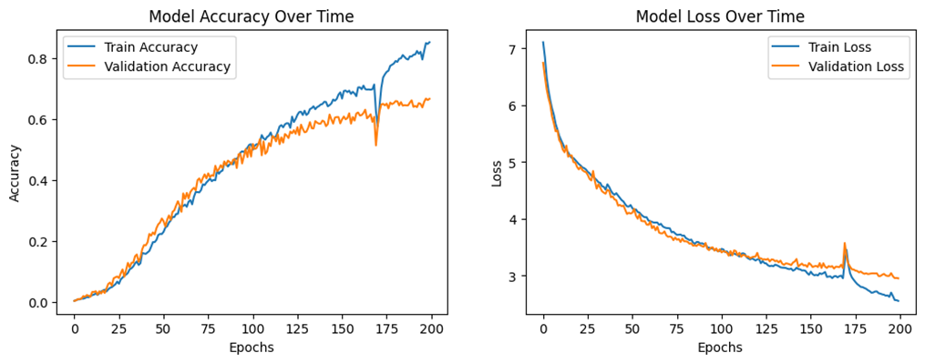
Model 2: Evaluation
Model Training Overtime:

Slide 51
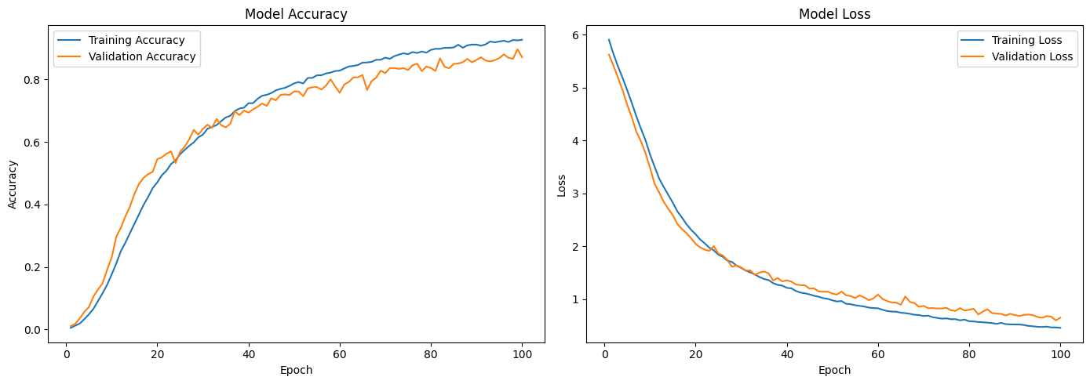
Model Evaluation
Model Training Overtime:

Slide 52
Text to Speech
Google TTS offers:
High-quality,
Natural-sounding speech with wide language support and
Flexible SSML controls, making it ideal for accessible and user-facing voice applications.

Slide 53
Why Google TTS
Natural Speech Output
SSML Control
Provides precise control over speech
parameters
Utilizes advanced voice models for
realistic speech
Google TTS offers:
High-quality,
Natural-sounding speech with wide language support and
Flexible SSML controls, making it ideal for accessible and user-facing voice applications.
Language and Voice Support
Offers broad language and voice options for diverse users

Slide 54
Google TTS Performance
System performance metrics
False Alarm Rate
The rate of false alarms is 17%.
Latency is between 200 and 600ms
Latency

Slide 55
AI Models
System Development
Cost & Sales
Future Work
Agenda

Slide 56
AI Models
System Development
Cost & Sales
Future Work
Agenda

Slide 57
System Development
Cost & Sales
Future Work
Agenda

Slide 58
Software Design

Slide 59
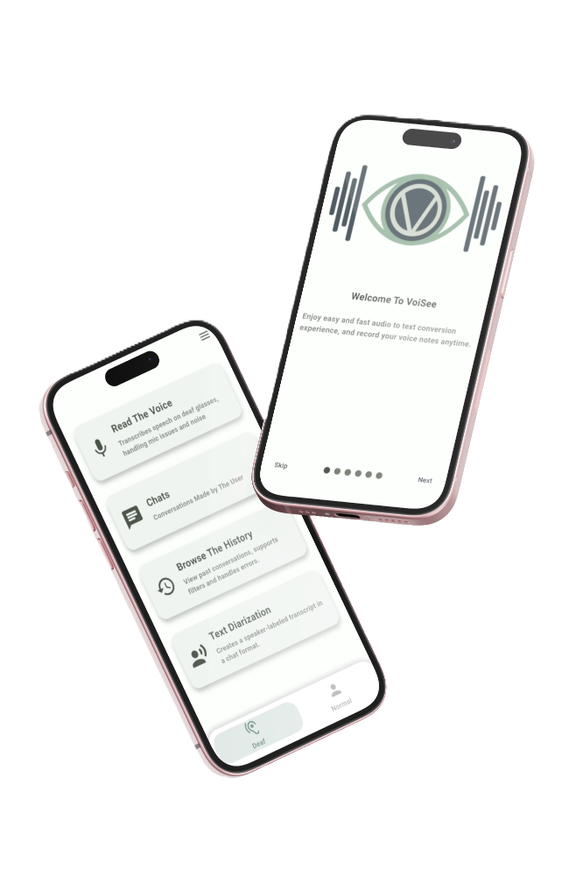
Application Showcase
VoiSee is a mobile app that facilitates real-time communication by converting speech to text and sign language to speech, enabling seamless interaction between deaf and hearing individuals.

Slide 60
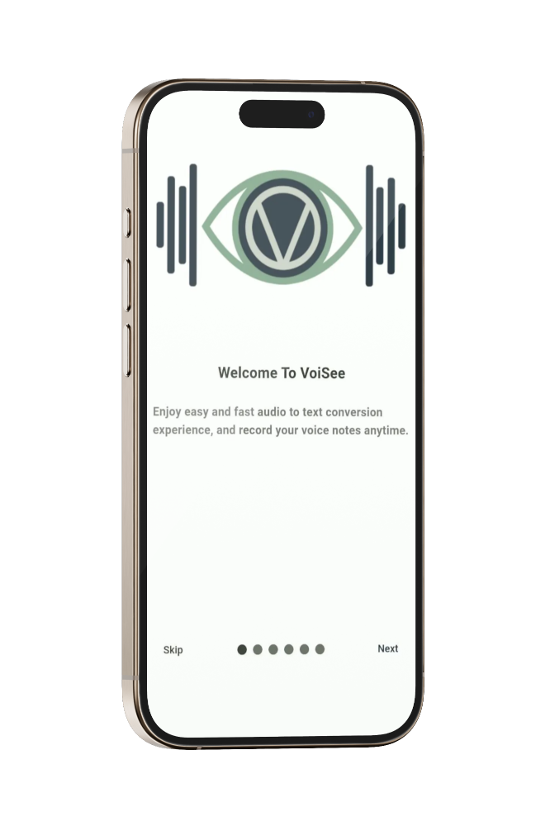
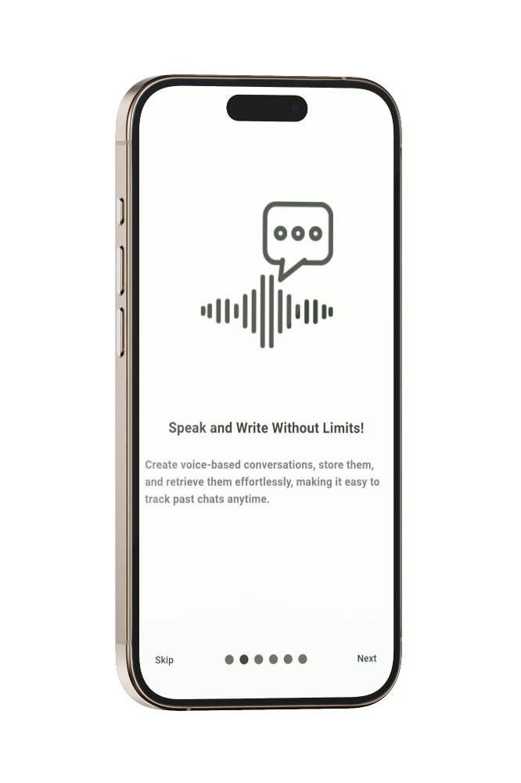
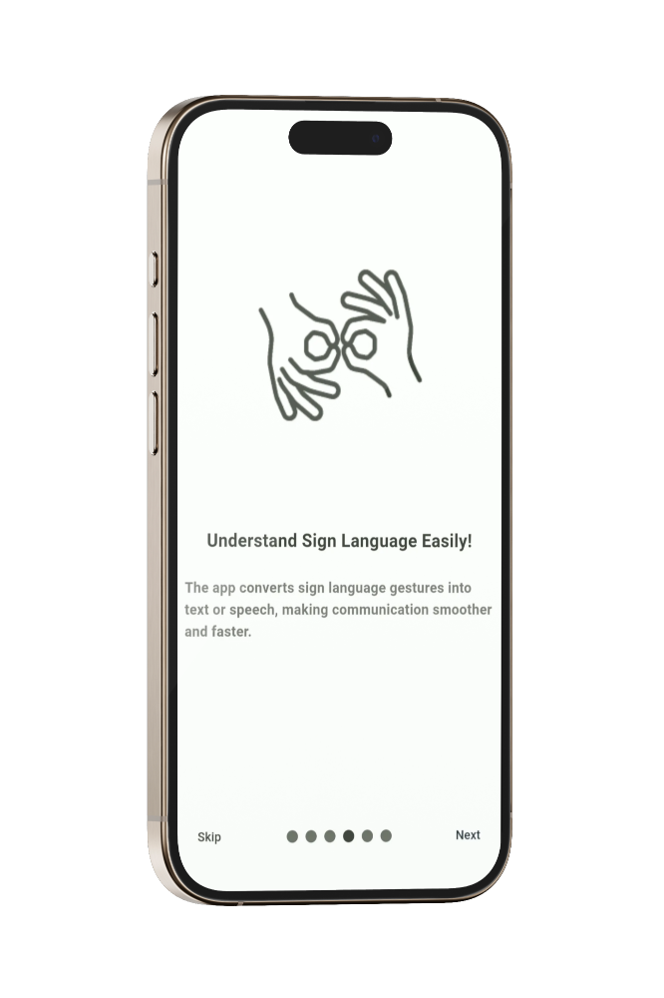
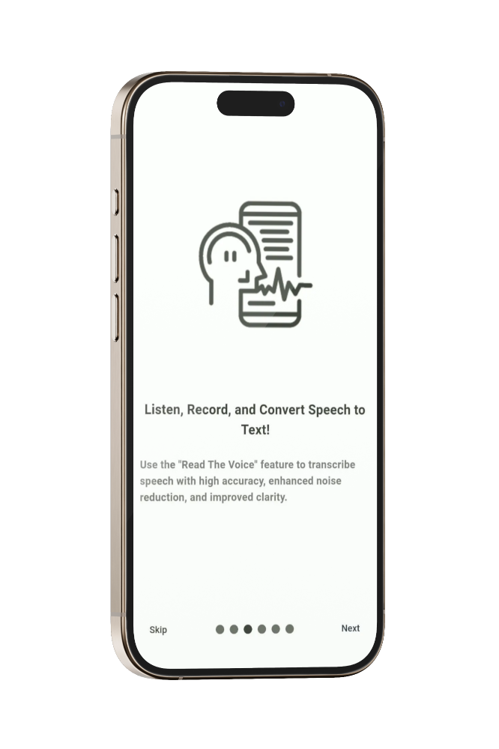
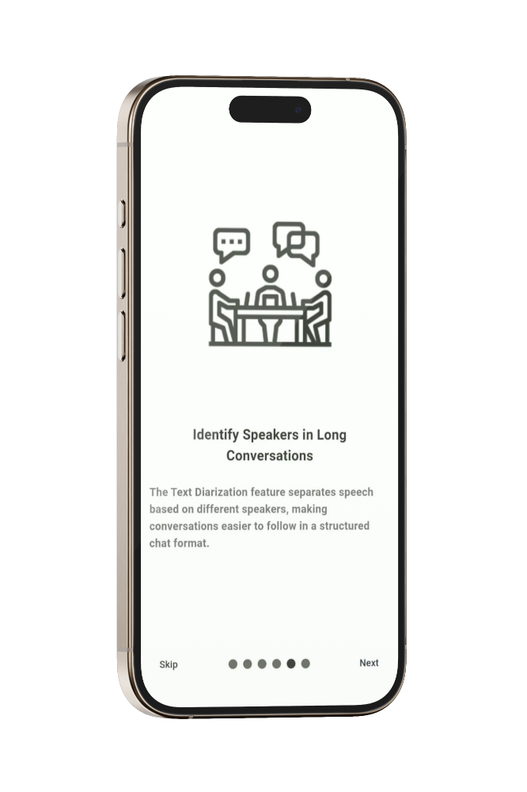
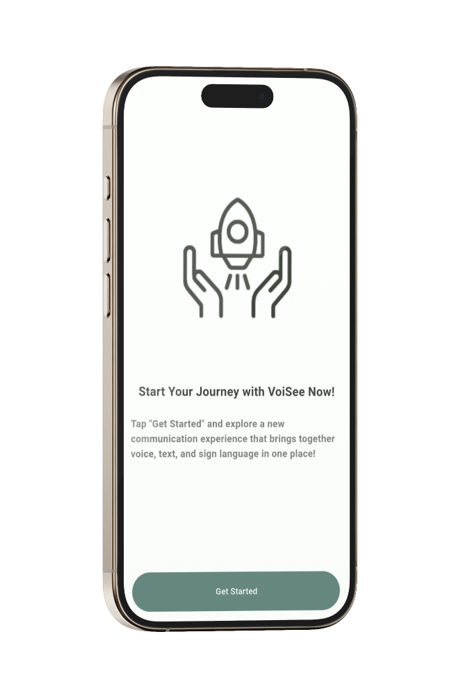
Application Showcase
Onboarding

Slide 61
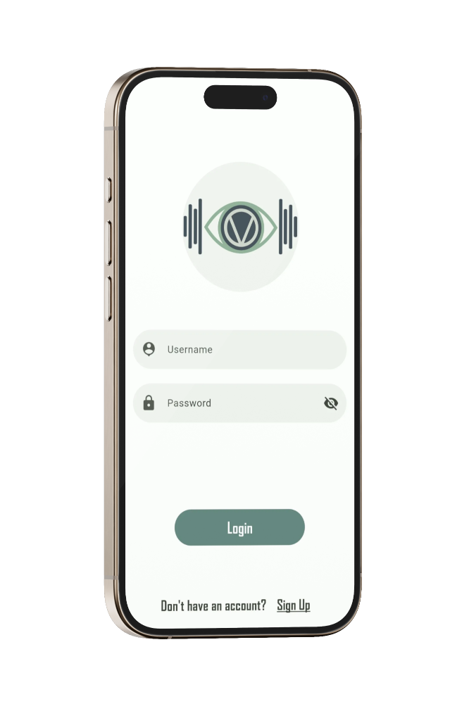
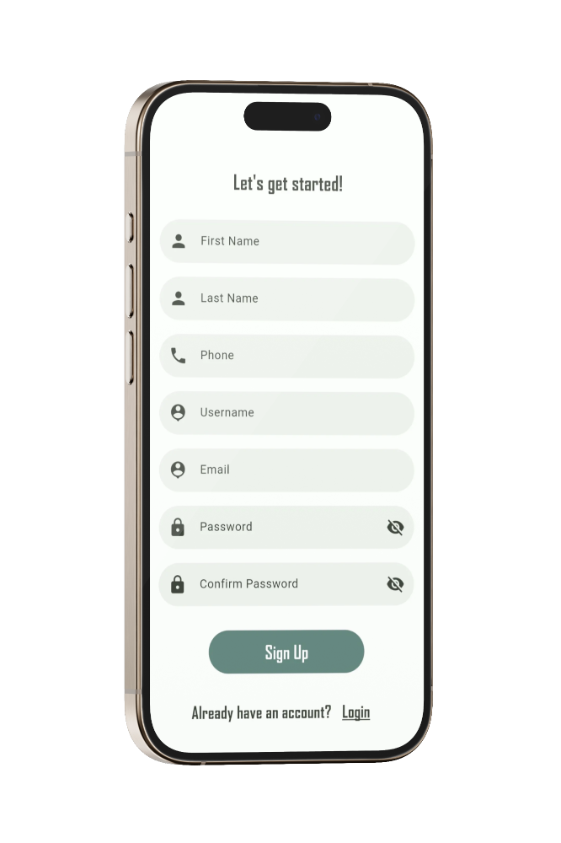
Application Showcase
Login & Signup

Slide 62
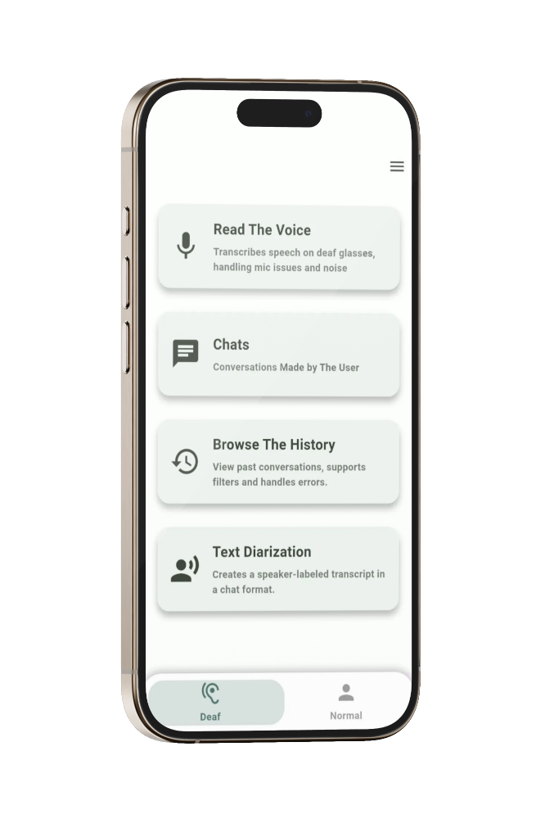
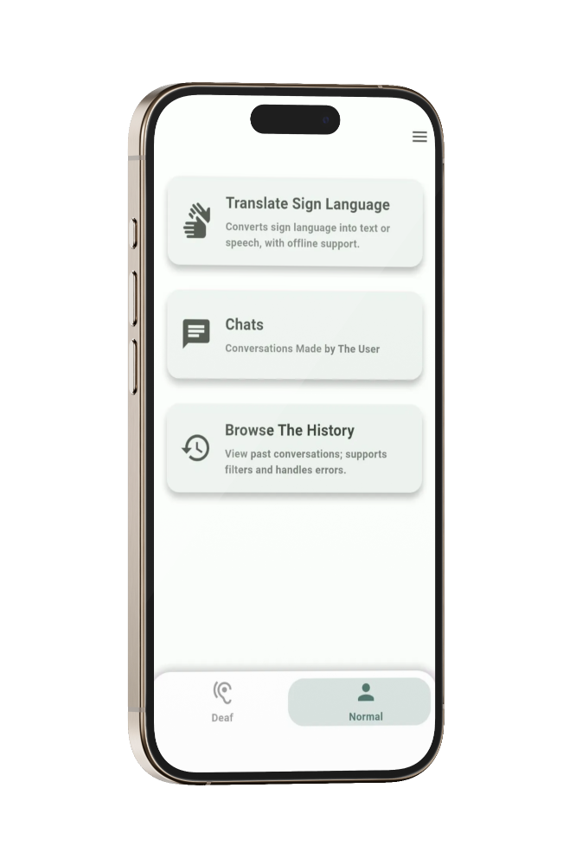
Application Showcase
Home Screens

Slide 63
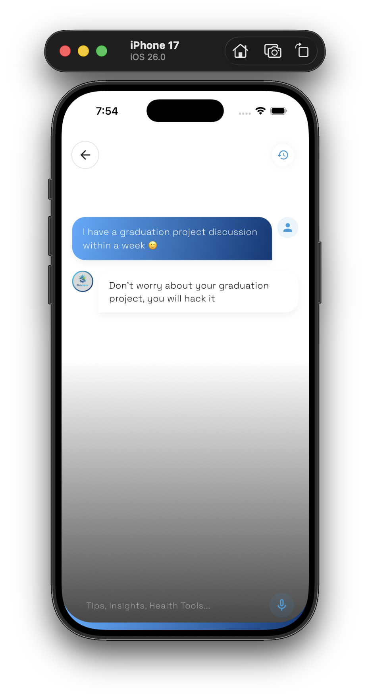
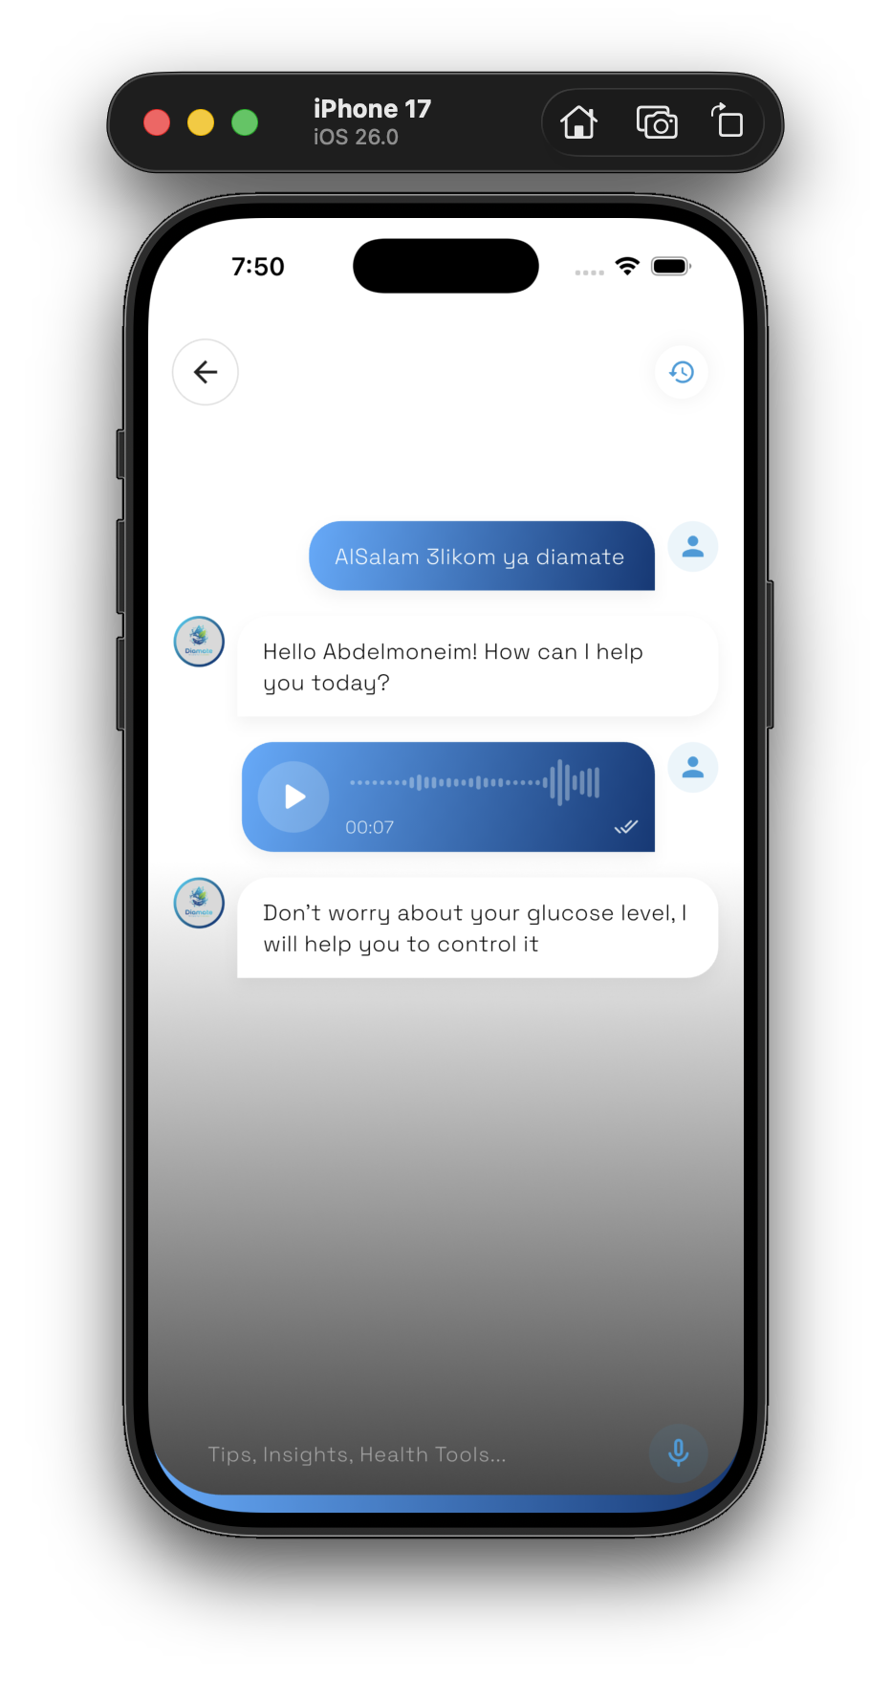
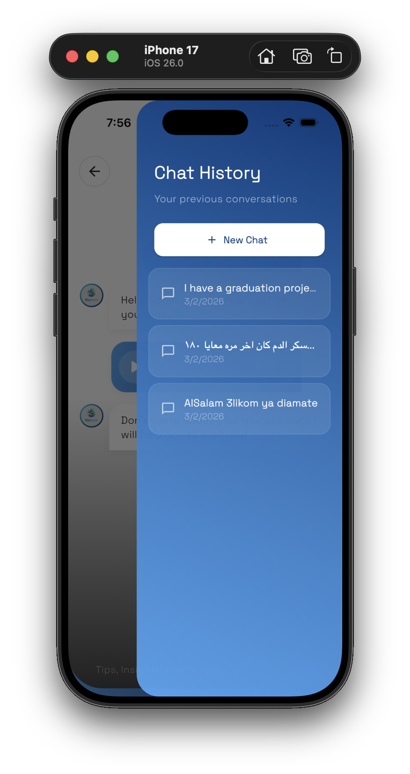
Application Showcase
Deaf Home Screen
Read The Voice

Slide 64
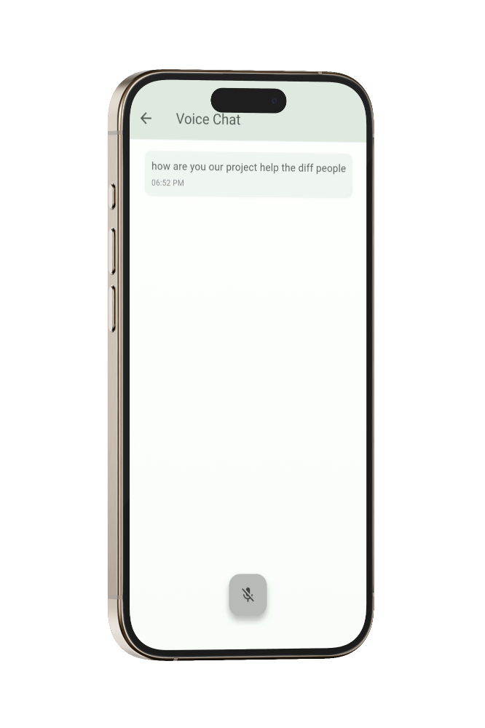
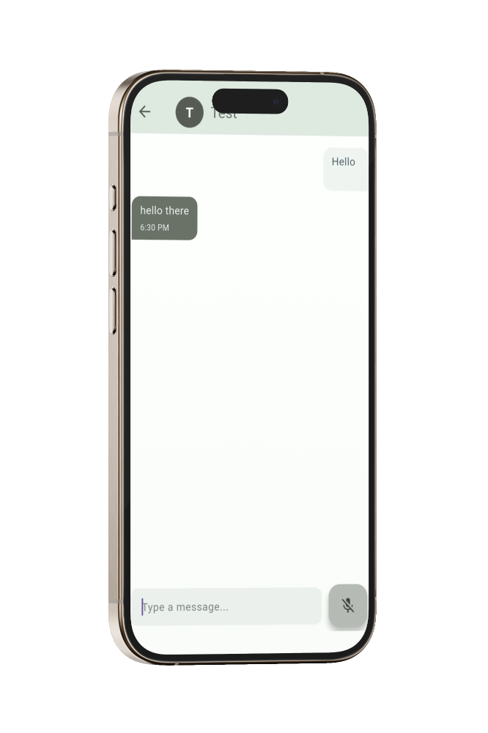
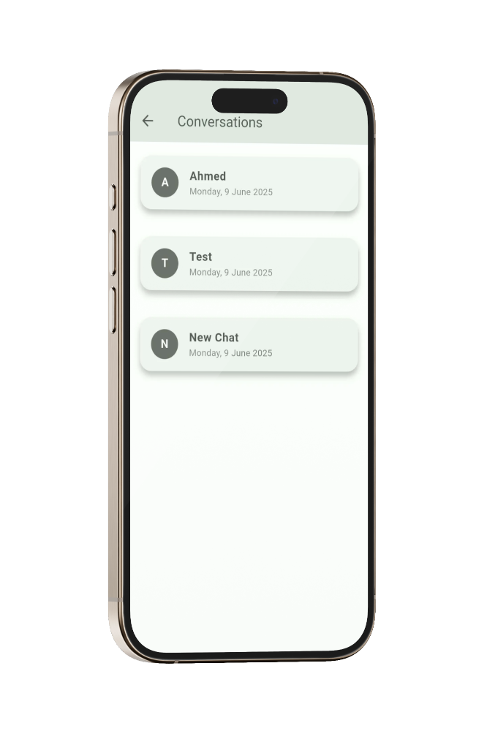
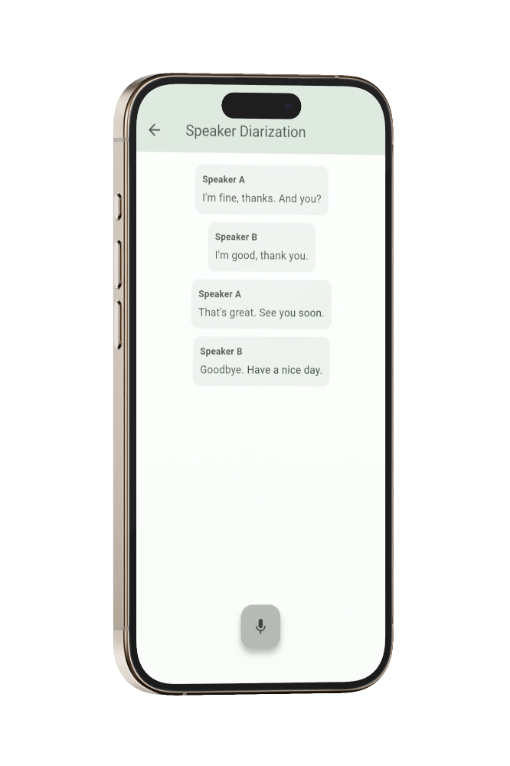
Application Showcase
Deaf Home Screen
Read The Voice

Slide 65
Application Showcase
Read The Voice
Chats
Browse The History

Slide 66
Application Showcase
Chats
Browse The History
Speaker Diarization
Read The Voice

Slide 67
Application Showcase
Browse The History
Speaker Diarization
Speaker Diarization
Read The Voice

Slide 68
Application Showcase
Speaker Diarization
Speaker Diarization
Read The Voice

Slide 69
Application Showcase
Home Screens

Slide 70
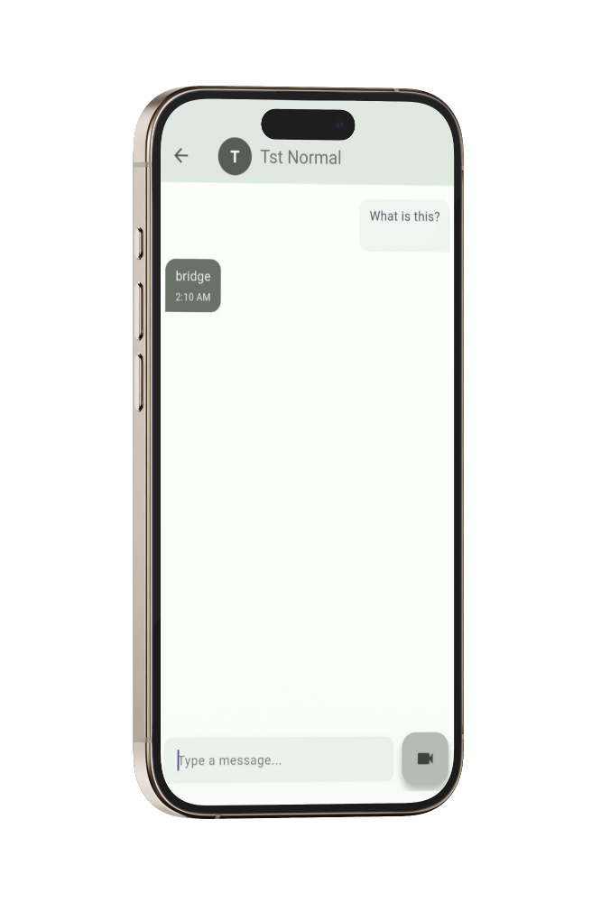
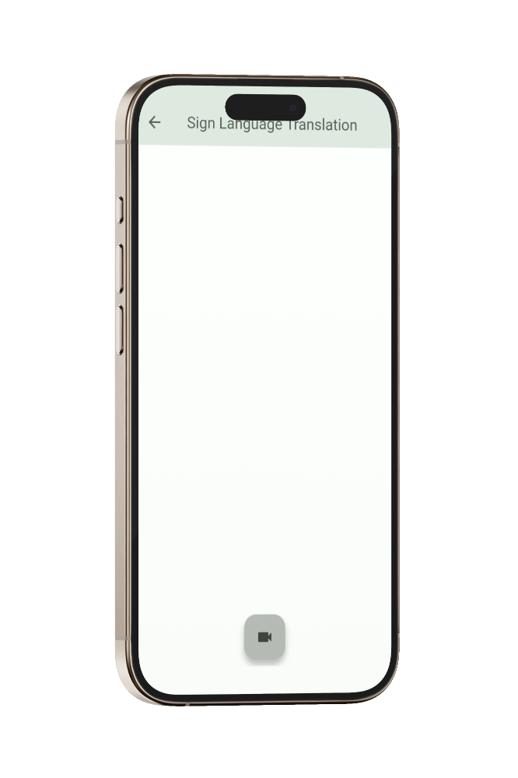
Application Showcase
Normal Home Screen
Translate Sign Language

Slide 71
Application Showcase
Translate Sign Language
Chats

Slide 72
Application Showcase
Chats
Browse The History

Slide 73
Application Showcase
Browse The History

Slide 74
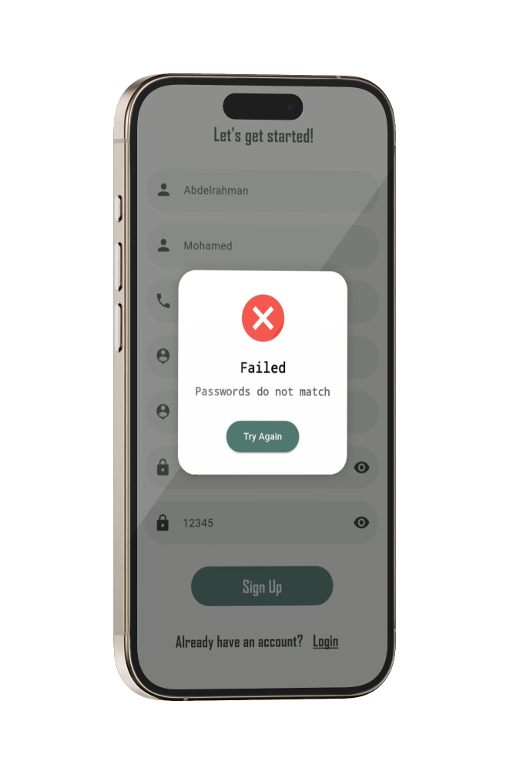
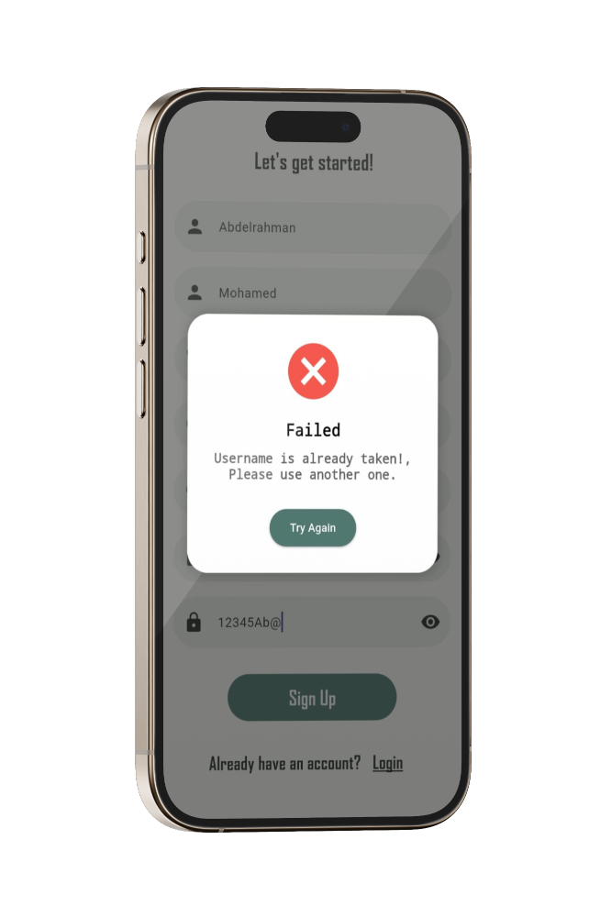
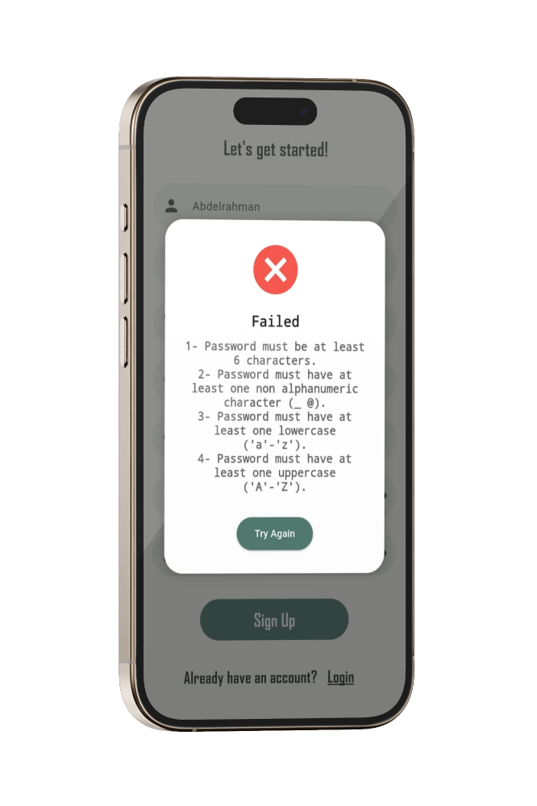
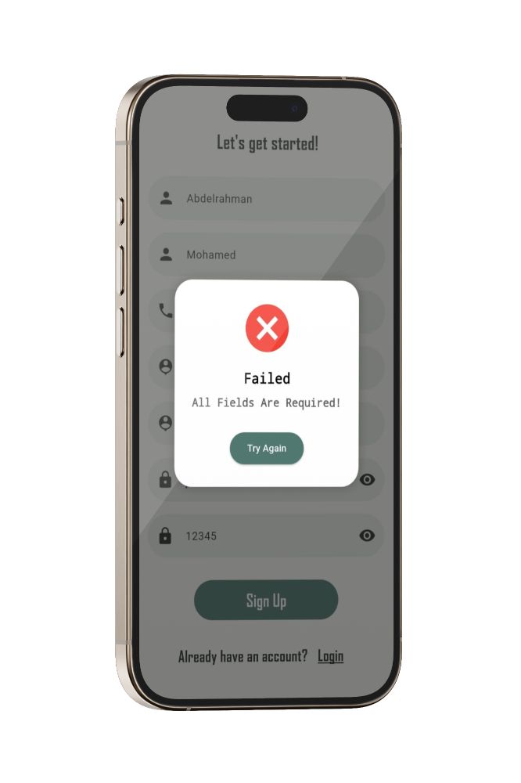

Error Handling

Slide 75

Application Experience
Translate Sign Language

Slide 76

Application Experience
Text Diarization

Slide 77
Hardware Design

Slide 78

Hardware Showcase
New Hardware housing design
Less weight
Removed old projection
Flexible prismatic joint

Slide 79

Hardware Showcase
OLED Screen 0.96 inch
SPH0645 I2S Microphone
New Hardware housing design
ESP32 Wroom32D
Turn Glass ON / OFF

Slide 80


Hardware Showcase
OLED Screen
4 Lines
7 Lines
Capture up to 12, or 21 words on one screen!!!

Slide 81
Communication Protocol

Slide 82


Communication Protocol
To enable seamless communication of both audio and text between the hardware and the mobile application, we implemented MQTT as our communication protocol.
For faster integration and reliable performance, we chose HiveMQ as our online MQTT broker.

Slide 83
How MQTT Works
Publisher
Mobile App Hardware
Broker
3
Subscriber
Central hub for message management
Mobile App Hardware
2
4
Message
Topic
Real Time Audio Text Recognized
1
5
Categorizes messages for subscription

Slide 84

Hardware Experience

Slide 85
System Development
Cost & Sales
Future Work
Agenda

Slide 86
System Development
Cost & Sales
Future Work
Agenda

Slide 87
Cost & Sales
Future Work
Agenda

Slide 88



Our Competitors
Transcribe Glasses
lightweight device that clips onto any glasses, displaying real-time captions in the user’s field of vision. It helps people who are deaf or hard of hearing stay engaged in conversations while maintaining eye contact.
Xander Glasses
smart glasses that transcribe speech into real-time captions visible only to the wearer. They offer a simple, hands-free solution for people with hearing loss to follow conversations naturally.
Cochlear Implant
A cochlear implant sends sounds past the damaged part of the ear straight to the hearing nerve, called the cochlear nerve.

Slide 89
Price Comparison
Name | Price
Cochlear Implant | 600,000 EGP
Xander Glasses | $4,999
Transcribe Glass | $377 + $20/mo.
VoiSee Glasses | $100 + $30/mo.

Slide 90
Cost Structure (Prototype)
Component | Approx. Unit Cost (EGP)
ESP32 WRoom | 750 EGP
OLED 0.96" Display | 170 EGP
Battery (LiPo for OLED) | 130 EGP
Wires, Connectors, PCB small parts | 40 EGP
Microphone (SPH0645 I2S) | 480 EGP
3D Printed Materials (PLA + Printing) | 320 EGP
Assembly + Miscellaneous | 1000 EGP
Total | 2890 EGP

Slide 91
Revenue Model
Assuming a retail price of 5000 EGP per unit:​
Selling Price: 5000 EGP
Cost of Goods Sold (COGS): 2890 EGP
Gross Profit: 2110 EGP
Gross Margin: ~42.2%
2020$ Gross Profit
5000$ Selling Price
2980$ Cost of Goods Sold (COGS)

Slide 92
Revenue Projections
Units Sold
Revenue (EGP)
COGS (EGP)
Profit (EGP)
100
500,000 EGP
289,000 EGP
211,000 EGP
500
2,500,000 EGP
1,445,000 EGP
1,055,000 EGP
1,000
5,000,000 EGP
2,890,000 EGP
2,110,000 EGP

Slide 93
Additional Revenue Opportunities
Direct Sales (B2C):
Amazon Egypt
Jumia
Institutional Sales (B2B):
Schools
Hospitals
Subscription Services:
Sign Language feature
Speech Recognition feature
Direct Sales
Institutional Sales
Subscription Services

Slide 94
Cost & Sales
Future Work
Agenda

Slide 95
Cost & Sales
Future Work
Agenda

Slide 96
Future Work
Agenda

Slide 97


Models Improvement
Integrating Google’s SignGemma Model
New AI model by Google for real-time ASL Translation.
Benefits:
Higher accuracy
Offline support
Better user experience
Support for complex signs

Slide 98

Develop models compatible with different smart glasses
Using Android XR Smart Glasses Plan to adopt Google Android XR in future versions
Why Android XR?
Better performance & battery life
Seamless integration with Android app
Built-in camera & sensors for gesture tracking

Slide 99








Team Members
Team Leader
Abdallah Ahmed Baghdadi
Member
Abdelrahman Karam Abu El khair
Member
Emad Tantawy Mohamed
Member
Abd El-Fatah Ahmed Abd El-Fatah
Member
Abdallah Hesham Gomaa
Member
Abdelrahman Mohamed Talaat
Member
Omer Hany Metwally
Member
Omar Ramadan Nabeh

Slide 100


THANK YOU!

Slide 101


